Slide 1
Electronic Devices
Mid Term Lecture - 04
Reference book:
Electronic Devices and Circuit Theory
Robert L. Boylestad and L. Nashelsky , (11th Edition)

Slide 2
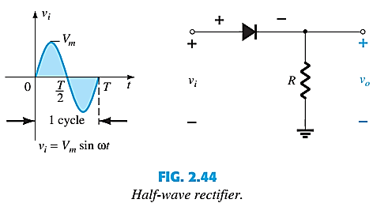
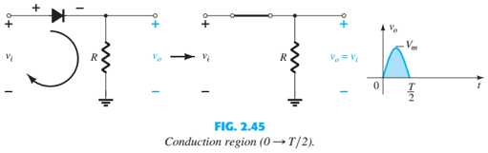
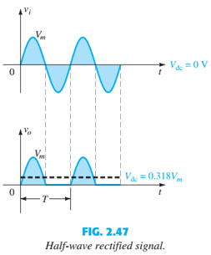
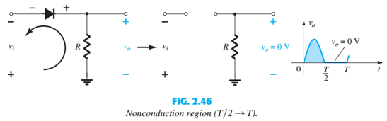

SINUSOIDAL INPUTS; HALF-WAVE

Slide 3
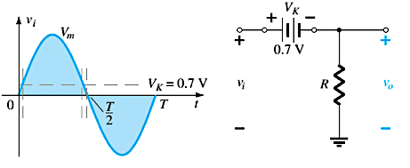
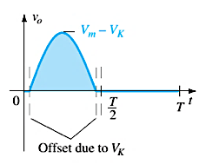

HALF-WAVE RECTIFICATION
The process of removing one-half the input signal to establish a dc level is called halfwave rectification.
The effect of using a silicon diode with V_{K} = 0.7 V is demonstrated in below Figure for the forward-bias region. The applied signal must now be at least 0.7 V before the diode can turn “on.”

Slide 4
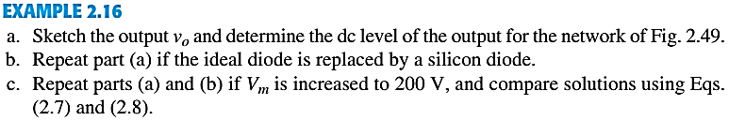
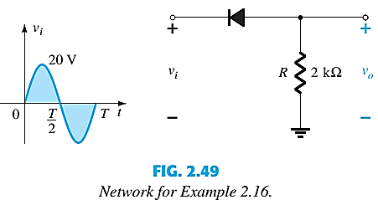
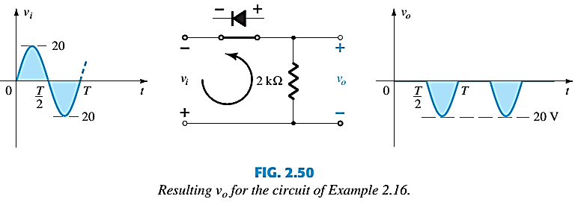
HALF-WAVE RECTIFICATION

Slide 5
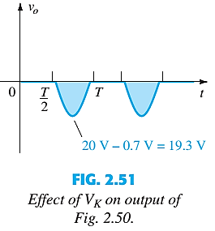
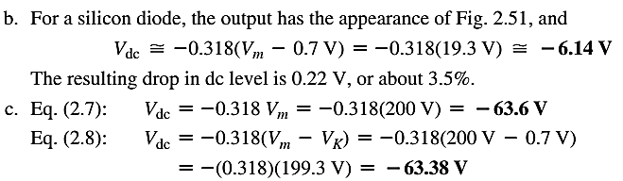
HALF-WAVE RECTIFICATION

Slide 6
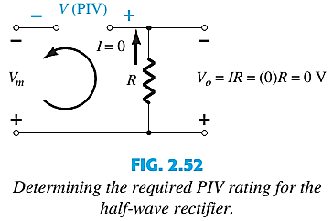

PIV (PRV)
It is the voltage rating that must not be exceeded in the reverse-bias region or the diode will enter the Zener avalanche region.

Slide 7
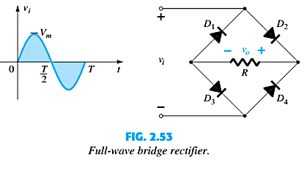
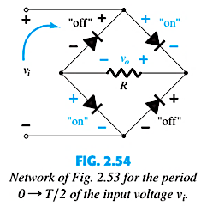
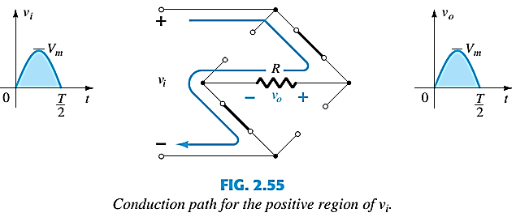
FULL-WAVE RECTIFICATION: BRIDGE NETWORK

Slide 8
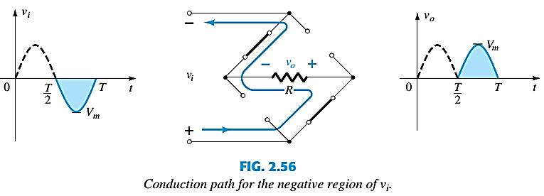
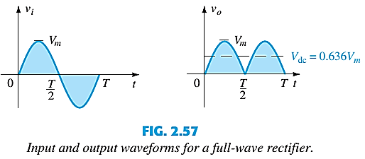
BRIDGE NETWORK

Slide 9
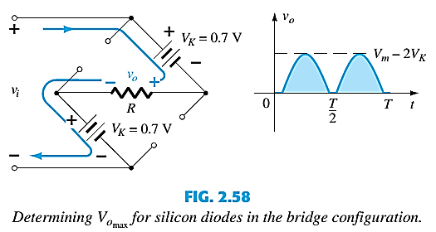

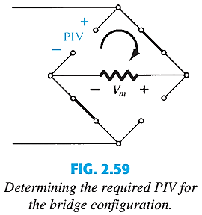

BRIDGE NETWORK

Slide 10
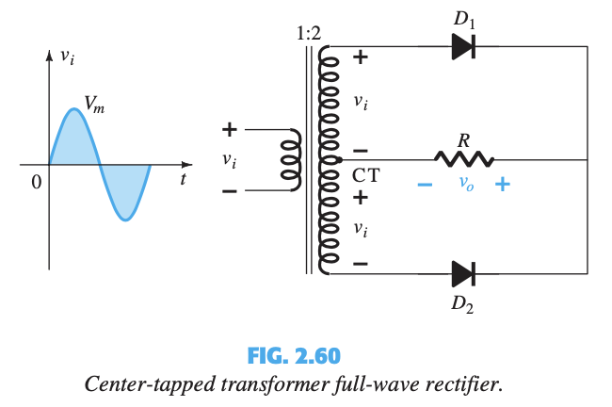
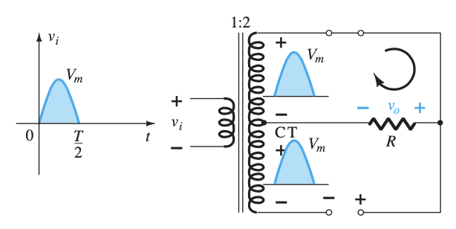
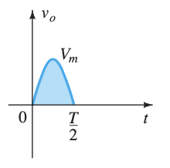
CENTER-TAPPED TRANSFORMER
Network conditions for the positive region of v_{i}

Slide 11
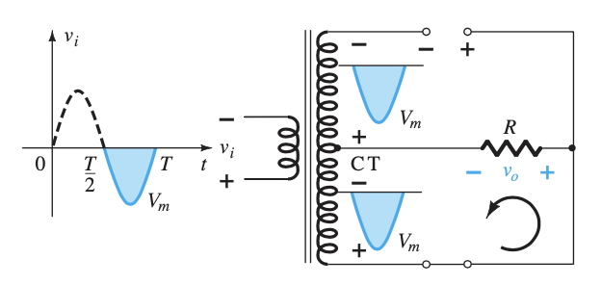
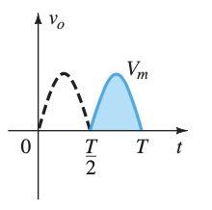
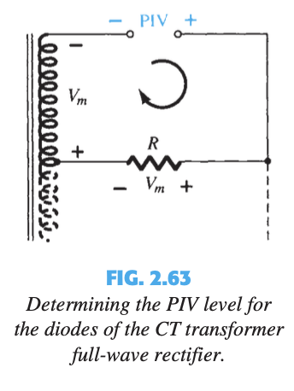
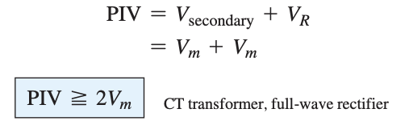
CENTER-TAPPED TRANSFORMER
Network conditions for the negative region of v_{i}

Slide 12
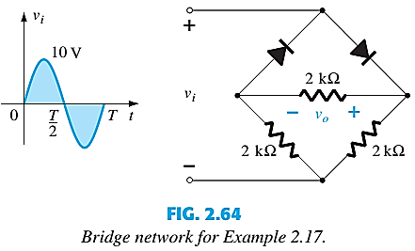
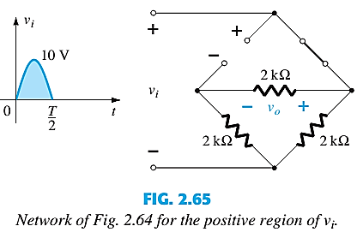
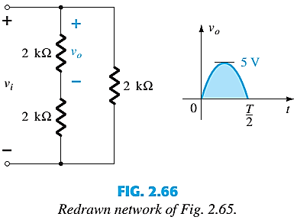
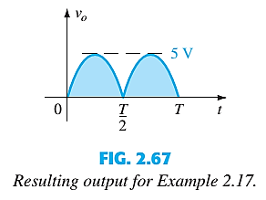

Slide 13
Thank You

